Slide 1
FLY_EMIRATES
ANALYSIS IN POWER BI

Slide 2
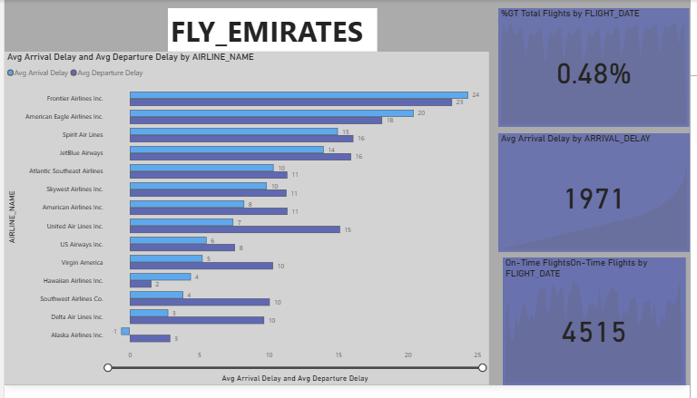

Slide 3
Main Insights:
Title: Avg Arrival Delay and Avg Departure Delay by AIRLINE_NAME
Bar Chart:
Compares average arrival and departure delays across various airlines.
Frontier Airlines Inc. and American Eagle Airlines Inc. have the highest average delays.
Alaska Airlines Inc. and Delta Air Lines Inc. show the lowest average delays.

Slide 4
Key Metrics (Right Panel):
Delay Percentage: 0.48% of total flights experienced delays.
Avg Arrival Delay: 1971 (unit not specified but likely in minutes or number of delayed flights).
On-Time Flights Count: 4515 flights were on time.

Slide 5
Conclusion:
This slide is part of a flight performance analysis, focusing on delay statistics by airline. It provides both a visual comparison and numeric summary, helping identify which airlines have better or worse performance in terms of punctuality.

Slide 6
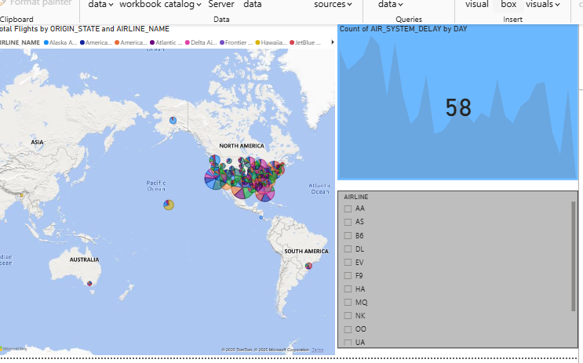

Slide 7
1. Topic:
The dashboard is to analyze flight delays, likely from U.S. flight data. Specifically, it shows:
Air System Delays by Day.
Airline-wise distribution of data.
A geographic map showing flight origins or delays across different locations (mostly within the U.S.).

Slide 8
2. Visuals:
Map Visualization (left):
Shows global map with concentrated data points in North America (U.S.), possibly representing airports or delay origins.
Area Chart (top right):
Displays Air System Delays by Day, with a highlighted count of 58 delays.
Filter Pane (bottom right):
Allows filtering by airlines (e.g., AA, DL, UA, etc.).

Slide 9
3. Insight:
The dashboard helps analyze flight delays, likely used for reporting or investigation. For example, it can help identify:
Trends in system delays over time.
Geographical regions most affected.
Airlines with frequent delays.

Slide 10
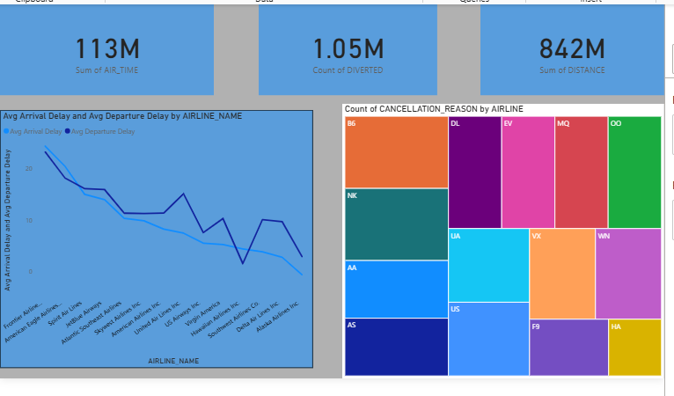

Slide 11
Key Metrics (Top Row Cards):
1. Sum of AIR_TIME: 113M
Total air travel time across all recorded flights
2. Count of DIVERTED: 1.05M
Number of flights that were diverted from their planned route or destination
3. Sum of DISTANCE: 842M
Total distance covered by all flights.
.
.

Slide 12
Visuals and Insights:
1. Line Chart (Bottom Left):
Avg Arrival Delay vs Avg Departure Delay by Airline
Compares average delay times for both arrivals and departures across different airlines.
Useful for identifying poorly performing airlines in terms of punctuality.
Trend shows which airlines are more delay-prone.

Slide 13
2. Tree Map (Bottom Right):
Count of CANCELLATION_REASON by AIRLINE
Color-coded block chart showing how many cancellations happened and which airline had which reason for cancellations.
Each colored box represents an airline; size of the box = number of cancellations.
Helps in root cause analysis (e.g., mechanical, weather, crew issues).

Slide 14
Overall Insight:
This dashboard provides a comprehensive overview of flight reliability and delays:
Measures key performance indicators like time, distance, and diversions.
Highlights airline-specific issues in delays and cancellations.
Useful for airline performance review, operational planning, or regulatory reporting.

Slide 15
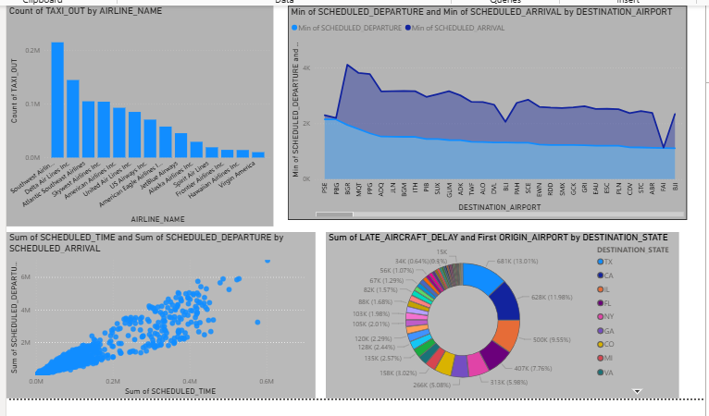

Slide 16
Top Left Chart: Bar Chart - Count of Taxi-Out Time by Airline Name
Shows how long different airlines take for taxi-out (the time from gate departure to wheels-off).
One airline has significantly higher taxi-out durations, possibly indicating inefficiencies or airport congestion.

Slide 17
Top Right Chart: Area Chart - Min of Scheduled Departure & Arrival by Destination Airport
Compares scheduled departure and arrival times across various destination airports.
The area under the curve shows consistency or variability in flight schedules over different airports.

Slide 18
Bottom Left Chart: Scatter Plot - Scheduled Departure vs Scheduled Arrival
Depicts correlation between scheduled departure and arrival times.
A strong linear pattern suggests consistent flight durations with minimal deviation.

Slide 19
Bottom Right Chart: Donut Chart - Delay Reasons (Late Aircraft & First Origin) by Destination State
Visualizes delay distribution by cause and destination state.
“Late Aircraft” appears to be a significant contributor to delays.
Helps identify states frequently affected by specific delay causes.

